Slide 1
Introduction to DBMS
Day 1

Slide 2
General Guideline
© (2021) ABES Engineering College.
This document contains valuable confidential and proprietary information of ABESEC. Such confidential and proprietary information includes, amongst others, proprietary intellectual property which can be legally protected and commercialized. Such information is furnished herein for training purposes only. Except with the express prior written permission of ABESEC, this document and the information contained herein may not be published, disclosed, or used for any other purpose.

Slide 3
Chapter Objective
To describe the Data, Information and DBMS.
To understand Data Models ,Types of Data Models, Advantages and Disadvantages of Data Models.
To compare File System and Database Management System
To explain Database System, Application and Server Architecture.
To explain the applications of Database Management Systems.
To understand the roles of different users in DBMS

Slide 4
Topics Covered
Day 1
Day 2
Day 3
Day 4
Introduction
Data and Information
Database and DBMS
File System Vs DBMS
History of DBMS
Data Models
Types of Data Models
Database System Architecture
Database Application Architecture
Database Server Architecture
Applications of DBMS
Database Users

Slide 5
Session Plan - Day 1
Data & Information
Introduction to Database Management System
File System
Issues with File System
History of DBMS

Slide 6
What is Data?
Roll number, student name, course name, branch name, date of birth, admission date are the facts about a student.
Book number, book title, author name, publisher name, purchase date, and price are the facts about a book in a library.
Data
Facts
Observations
Figures
Statistics
Eg. of Data
Database+DBMS
6

Slide 7
DATA & DATA RECORDS
Each piece of fact is technically called a datum, and the plural of datum is called data.
The collection of related data fields for a particular individual or item is called a data record. For Example:
In the Figure, Roll number, student name, course name, branch name, date of birth, admission date about a student say Ram is an example of Data Record.
Roll number | Student Name | course name | branch name | date of birth | admission date
101 | Ram | B.Tech | CSE | 12-May-2001 | 03-Jun-2020
102 | Shyam | MCA | NA | 16-Apr-2002 | 04-Apr-2021
7

Slide 8
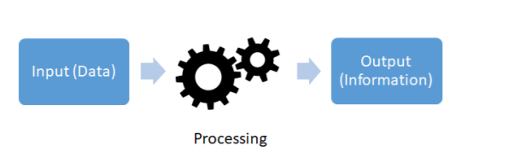
Information
Data needs to be processed using a set of procedures to convert it into information.
Eg. Number of Students in a particular branch, Number of students below age of 23
7

Slide 9
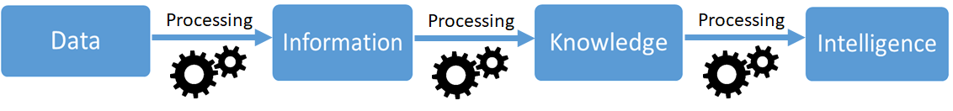
Information
If a student scores greater than 90 marks in specific course that can be indicator of the area of interest of that student. This represents the “Knowledge”.
An intelligent system can be build using the acquired knowledge to recommend the job to the student according to their area of interest. This represents an “Intelligence”.
Therefore, data plays a very important role in building intelligent systems. We cannot build intelligence systems until we have a correct and comprehensive set of data.
The relationship can be depicted in Figure as:-
7

Slide 10

Database Management System
DataBase
DataBase Management System
(DBMS)
(eg. PostgreSQL, MYSQL, Microsoft Access, SQLite.)
Organized collection of related data, typically stored in a computer system.
It is the software that is used to manage the database.It allows the users to carry out tasks like Data Definition, Data Updation, Data Retrieval & User Administration
User will communicate with DBMS Interface to fulfill his/her requirements
9

Slide 11
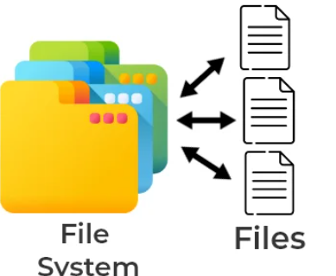
File System
File systems consist of different files which are grouped into directories. The directories further contain other folders and files.
The file system performs basic operations like management, file naming, giving access rules, etc.
Eg. NTFS (New Technology File System), EXT (Extended File System).
10

Slide 12
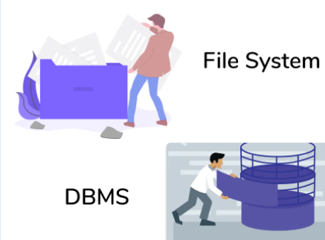
File System vs DBMS
Earlier the data were stored in a file format where the data is stored in one file or set of files.
This is new-age software that maintains the data stored in a organized format with various different entities having logical relationships amongst one another.
12

Slide 13
File System vs DBMS
Parameter | File System | DBMS
Definition | File system is a software that manages and organizes the files in a storage medium within a computer. | DBMS is a software for managing the database.
Data Redundancy | Redundant data can be present in a file system. | In DBMS there is no redundant data.
Backup and Recovery | It doesn’t provide backup and recovery of data if it is lost. | It provides backup and recovery of data even if it is lost.
Query Processing | There is no efficient query processing in file system. | Efficient query processing is there in DBMS.
Data Consistency | There is less data consistency in file system. | There is more data consistency because of the process of normalization.
Complexity | It is less complex as compared to DBMS. | It has more complexity in handling as compared to file system.
Security | File systems provide less security in comparison to DBMS. | DBMS has more security mechanisms as compared to file system.
Cost | It is less expensive than DBMS. | It has a comparatively higher cost than a file system.
13

Slide 14
History of DBMS
The first general-purpose DBMS was designed by Charles Bachman at General Electric in the early 1960s, called the Integrated Data Store.
.
It formed the basis for the network data model, which was standardized by the Conference on Data Systems Languages (CODASYL) and strongly influenced database systems through the 1960s.
The other important events in history are mentioned below:
- 1970: E.F. Codd from IBM introduces the concept of relational databases and the first normal form
- 1971: second and third normal form are introduced by Codd
- 1974: Boyce-Codd normal form is introduced
- 1976: the entity-relationship model is introduced by Peter Chen from MIT
- 1978: the first release of Oracle DB, based on IBM’s papers
- 1979: public release of Oracle Version 2 (version 1 was never released)
- 1983: the very first release of IBM DB2 database
14

Slide 15
MCQ’S
1 | DBMS is an interface between ____ and ____
A | Database and User
B | Database Application and Database
C | Database and SQL
D | Data and Database
Difficulty Level | Easy
Exam Type | http://www.c4learn.com/mcq/database-mcq/introduction-to-database-multiple-choice-questions-set-1/2/
15

Slide 16
MCQ’S
2 | In general, a file is basically a collection of all related______.
A | Rows & Columns
B | Fields
C | Database
D | Records
Difficulty Level | Easy
Exam Type | https://www.javatpoint.com/dbms-mcq
16

Slide 17
Review Questions?
Q No 1. What is difference between Data & Information?
Q No 2. What is DBMS? What are the uses of DBMS?
Q No 3. Comparison between File System & DBMS?
Q No 4. What are the issues with File System?
Q No 5. What is the history of DBMS?

Slide 18
References
https://www.javatpoint.com/dbms-mcq
http://www.c4learn.com/mcq/database-mcq/introduction-to-database-multiple-choice-questions-set-1/2/

Slide 19
Thank You

